Slide 1
Electricity Monitoring and Conservation
Internal advisor: Dr. Najmi Haider

Slide 2
Team Members
Muhammad Aamir Ali BESE-067
Nida Masood BESE-044

Slide 3
Individual Roles
Back-end Development
Hardware Design and Development

Slide 4
Individual Role
Front-end Development
User Interface design and development

Slide 5
Project Scope
To monitor the electrical load for subjected devices
To analyze and intercept future load

Slide 6
Project Composition
Web User Interface
Python Time Series
Mongo DB
Arduino
Raspberry-Pi

Slide 7
Web UI
Pico Server; Session independent variables
Java Script; Data visualization and Report Generation
Java Script; Data comparison between loads and small calculations

Slide 8
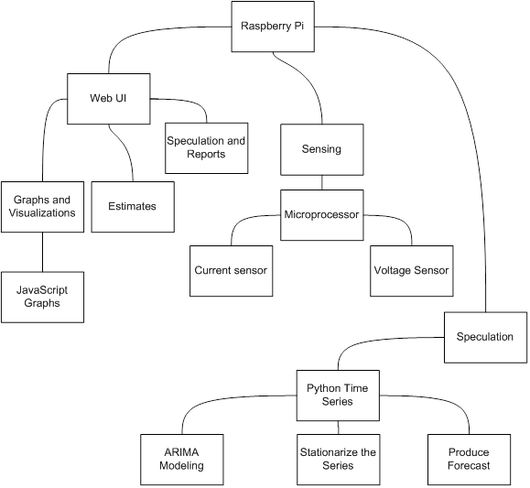
System Architecture

Slide 9
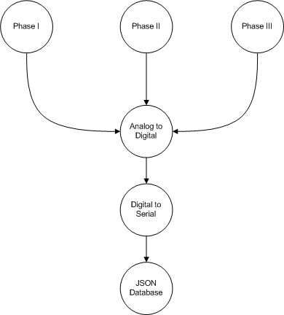
Overall Data Flow

Slide 10
Technologies Used
Arduino
Raspberry-Pi
Time Series
Java Script

Slide 11
Sub-system Interconnections

Slide 12
Arduino
Highly Customizable Micro-processor
Comes in Credit-Card Sizes
Digital Input and Output pins, 54 in count
Analog Input and Output pins, 16 in count
16 MHz CPU
128 Kb Flash Memory
Can run using 5 volts DC (or USB)

Slide 13
Raspberry-PI
A system on a chip
Also comes in Credit-Card Size
Contains almost same computing functionalities as a PC
Runs on Linux based System
Has General Purpose Input Output pins

Slide 14
Role of Java Script
Bill Calculation, With K-Electric Slab
Visualization of Data
Report Generation
Interaction with the user, such as inputting budget for prediction interception

Slide 15
Role of Java Script
Handles user-given variables
Catches Data from Python Pico
Throws Data to the Python Pico

Slide 16
Python Time Series
A Time-Based Series
Autoregressive Integrated Moving Average model (ARIMA)
Calculation of Up-coming data using Historical Data

Slide 17
Questions ?
( End )

